Slide 1
Cancer Biology Biol 445
Spring 2020
Dr. Heidi Super
Lecture 23
3-30-2020

Slide 2
Where were we?
Mutagens and carcinogens---what is the difference?
Retrospective and prospective studies of cancer in populations.
What does figure 4-2 show—why is this important to identifying a carcinogen?
Why must we be aware of the relative risk of getting a particular type of cancer before we study a particular carcinogen?

Slide 3
What’s an IACUC? Why is it important to have one at any institution doing research involving animals?

Slide 4
US law requires that new chemicals be tested in animals before they are released for human use.
Components of cookware, clothing, construction materials…
Testing is not just for carcinogenicity---general health effects.

Slide 5
Moving on….
Let’s return to mutagens/potential carcinogens…..Where do you start in showing experimentally something causes cancer?

Slide 6
Potential carcinogens…
A typical experiment.
A group of humans show a significant incidence of a specific type of cancer
Some connection/overlap is noted among the humans—same drinking water, same occupation, exposure to the same environment
Common chemical is found in the common environment.

Slide 7
Hypothesis…
Chemical X causes cancer type Y.
Chemical is tested for mutagenic potential—in vitro (discussed soon)
Chemical tested in animal models.
Table 4-1/figure 4-2

Slide 8
Dose control
One of the major challenges in transferring animal model data to humans is in getting the dose within reasonable environmental exposure range.
Saccharin used to be the only artificial sweetener for soda etc. Animal models showed saccharin was a carcinogen. First studies reported were only able to estimate extremely high consumption of saccharin in humans (100s sodas/day)

Slide 9
Still…Use of saccharin is limited in commercially produced foods.
Next---how do you read a dose-response curve?

Slide 10
% of those exposed who get cancer

Slide 11
% of those exposed who get cancer
Threshold---Concentration that has any affect
Concentration that affects 50 % of test subjects
Concentration of the chemical

Slide 12
Sometime the concentration measured is called LC50 (for the concentration that is lethal to 50% of the test subjects)
OR
LD50 (lethal dose for 50% of the test subjects)

Slide 13
Who studies cancer as a disease?
Attempting to find direct causes and mechanism for spread?
Epidemiologists—
Local and state health departments
National organizations
Centers for Disease Control (CDC)

Slide 14
First studies in epidemiology attempt relate disease incidence or death to some factor.
4-7

Slide 15
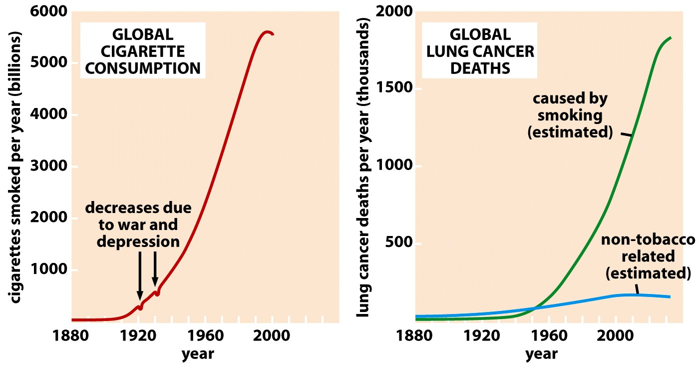
Figure 11.2 The Biology of Cancer (© Garland Science 2007)

Slide 16
Be careful not to confuse correlation with causation.
http://www.tylervigen.com/spurious-correlations

Slide 17
Epidemiologist try to eliminate unseen factors that might influence/bias how cancer and an environmental factor are connected.

Slide 18
Your text mentions several catagories of bias
Detection bias---many diseases are simply easier to detect than they were in the past.
e. g. Prostate cancer rates may have seemed to rise, but the rise, in part is due to widespread use of the PSA test and education about checkups.

Slide 19
Selection bias:
A cross section of the population may not represent the general population, or may have underlying health problems that skew the data.
Healthy controls may not represent the average person either.

Slide 20
Publication/statistical bias.
Scientists use a somewhat arbitrary cutoff of p<5% for cause-effect criteria. One study of many may show a low, but statistically significant link to cancer and thus get published in scientific literature.
Concern may be exaggerated because the study is publishable. (When multiple similar studies aren’t)

Slide 21
Limiting animal testing…
1975—Bruce Ames, developed a test using bacteria to see, first, if a chemical, was a mutagen.
Assumed (not yet proven) that cancer was the result of mutations.
Allowed better fine tuning of dose and comparisons of chemicals
Strong mutagens Potent carcinogens
Weak mutagens Rarely carcinogens

Slide 22
The Ames test
1. Obtain test compound
2. Combine with animal cell lysate containing enzymes which might activate the test compound. (Mutagens are often metabolic intermediates of the actual compound).
3. Add to bacteria unable to grow on the media provided (mutant lacking an enzyme)
4. Look for revertants which CAN grow on the incomplete medium.

Slide 23
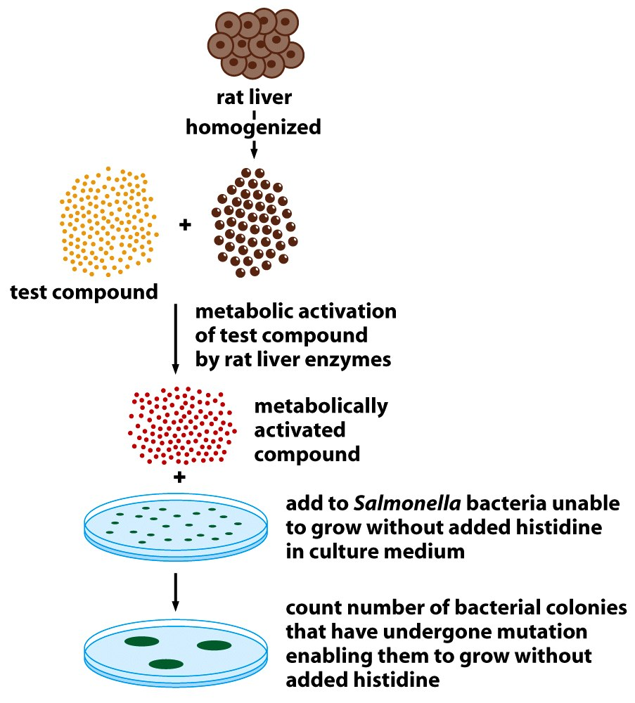
Figure 2.24 The Biology of Cancer (© Garland Science 2007)

Slide 24
Testing of many compounds shows excellent correlation in mutagenicity and carcinogenicity.
The following slide compares mutagenicity in bacteria with ability to cause tumors in mice for several chemicals. Carefully study and compare.

Slide 25
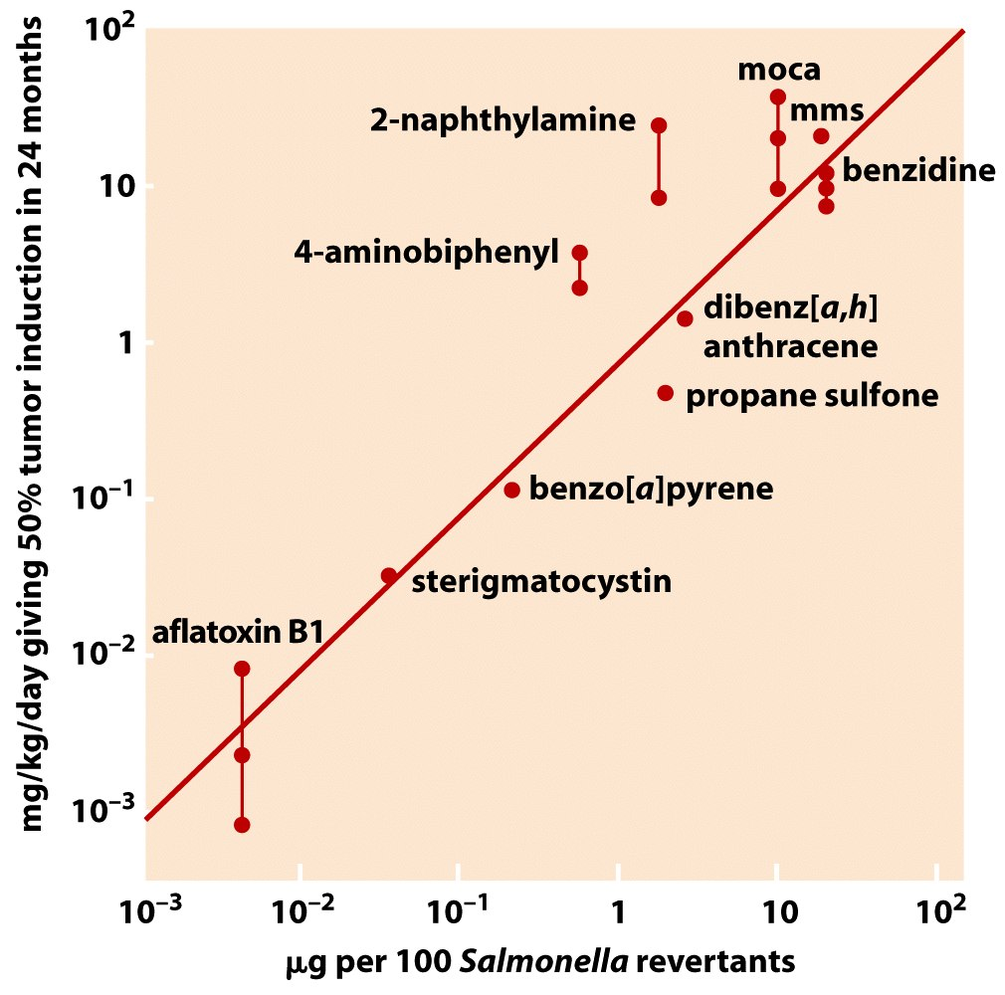
Figure 2.25 The Biology of Cancer (© Garland Science 2007)

Slide 26
Ames tests/Animal testing fail to identify a class of cancer-associated agents…
Tumor promoters
Agents that act on cells AFTER accumulated mutations have initiated abnormal growth.
Most lead, indirectly, to mutations by simply increasing the rate at which the clone of cells divide.

Slide 27
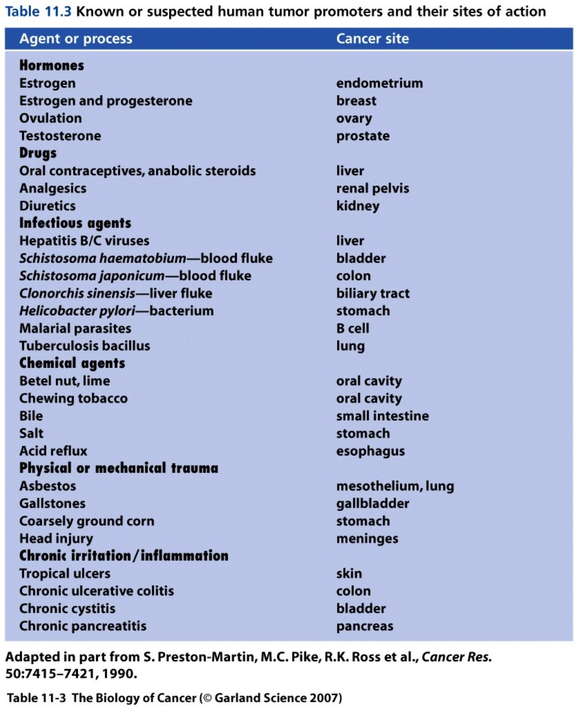
Tumor promoters

Slide 28
The most important factor…?
AGE!
Figure 4-4

Slide 29
Cancer….is it in the genes or environment/behaviors?
Figure 4-4 (genetic comparison)
Figure 4-6 (country to country comparison)

Slide 30
Behavioral risks…
Tobacco use:
Estimated that smoking is still responsible for about 30% of all cancer deaths.
Why?

Slide 31
Cigarettes/tobacco smoke are choc full of chemical carcinogens.
Table 4-2

Slide 32
Despite the challenge in linking cause to disease, smoking is unquestionably the largest risk-factor for many types of cancer.
Cause-effect criteria?
Cause precedes the disease.
Overlap or parallel trends
Dose-response effect
Statistical significance and > 2-fold increase
Elimination of bias

Slide 33
Figures 4-7
4-9
4-8

Slide 34
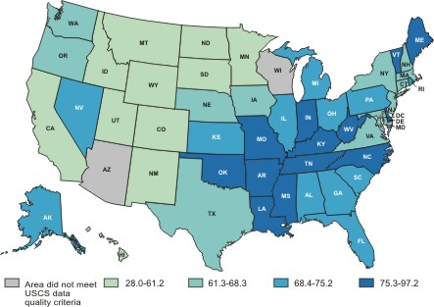
Lung cancer Incidence
Age adjusted rate/100,000 people

Slide 35
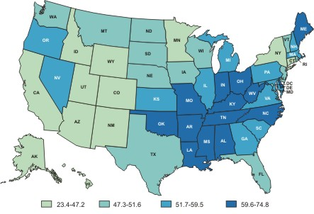
Lung cancer Deaths
Age adjusted rate/100,000 people

Slide 36
A sobering, effective attack ad for smoking
2007? Why was it effective?
http://www.youtube.com/watch?v=zuh2w2sFRMI

Slide 37
Recent discovery of new type of lung cancer
Found in “never smokers”

Slide 38
Never-smoker lung cancer
Accounts for as much as 15% of lung cancer cases
Molecular studies show a unique subset of DNA mutations associated with the NS lung cancer
MORE mutations than smoker-related lung cancer. (possibly more genetic instability)
Mutations in epidermal growth factor receptor (EGFR)
SOURCE: The Ninth Annual AACR Frontiers in Cancer Prevention Research Conference, 7 – 10 November 2010

Slide 39
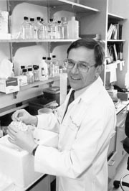
Stanley Korsemeyer—Contributed tremendously to understanding of cancer---specifically, lymphoma.
Died of NS Lung cancer age 55

Slide 40
What about alcohol?
Mostly considered a tumor promoter—where ingestion allows contact with epithelium.
Increased cancer-risk for mouth, throat and stomach cancers
Leads to chronic inflammation—cirrhosis in liver—increased incidence of liver cancer

Slide 41
Alcohol seems to act synergistically with tobacco in inducing cancers of the throat and mouth.
http://archotol.ama-assn.org/cgi/reprint/130/3/303
(Paper to read)
4-10 YIKES!

